Slide 1

Orientation Program on Data Structure Course Code: CSC303 Subject Teacher : Dr.N.P.Karlekar
MGM’S College of Engineering and Technology
Department of Computer Engineering
2021-2022
1

Slide 2
DATA STRUCTURES
CE– SE–DS
Dr.N P Karlekar
Associate Professor
Dept. of Computer Engineering
2

Slide 3
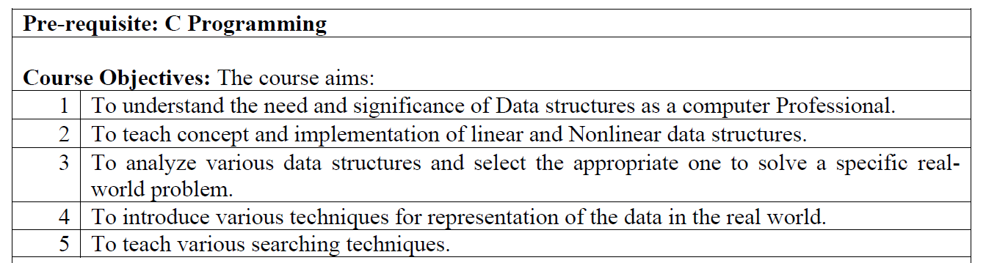
Course Objectives
Course objectives:
3

Slide 4
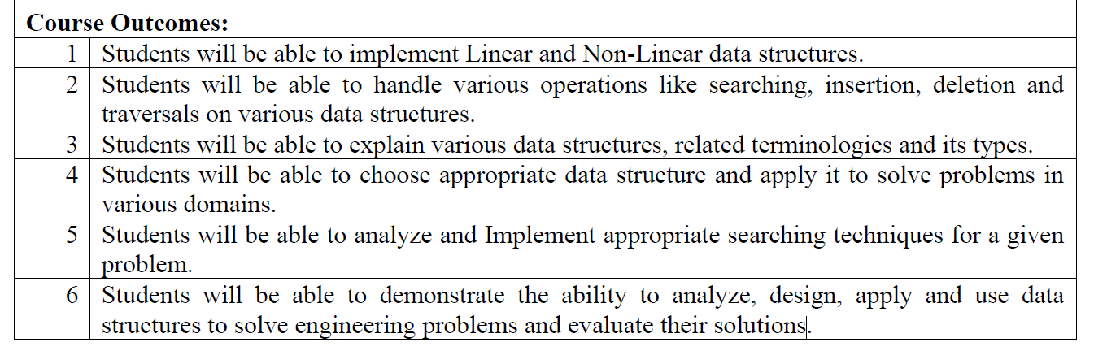
Course Outcome
Course outcomes:
4

Slide 5
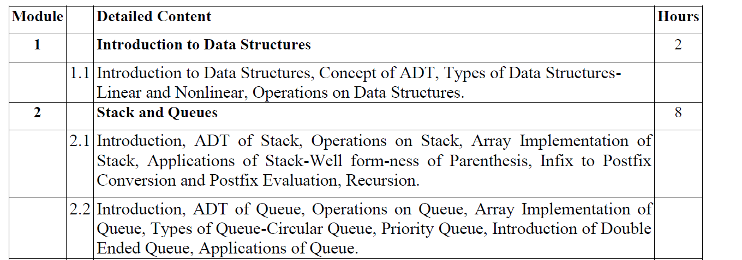
Syllabus
5

Slide 6
Syllabus
6

Slide 7
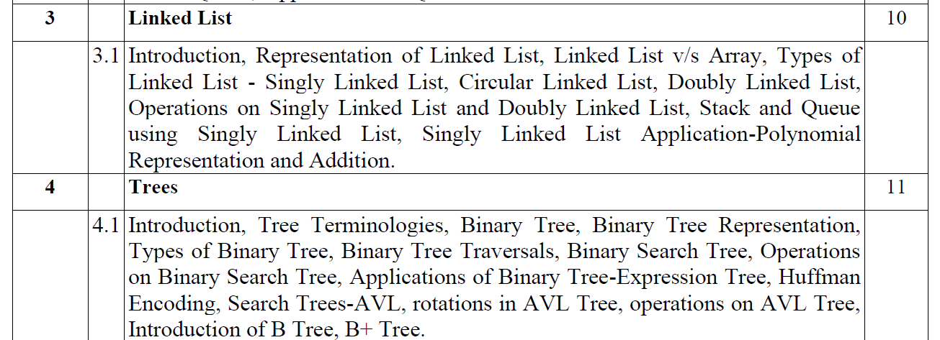
Syllabus
7

Slide 8
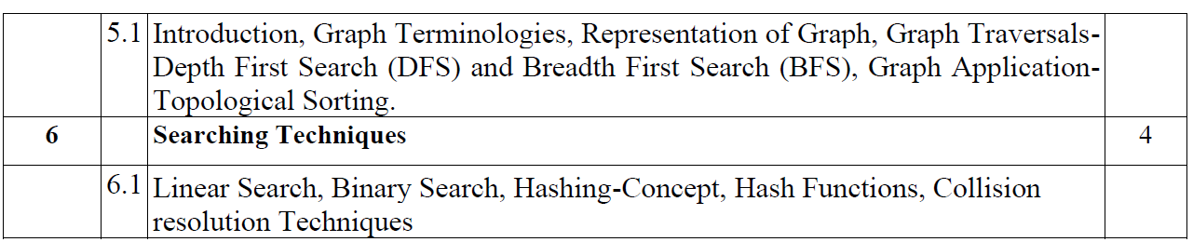
Syllabus
8

Slide 9
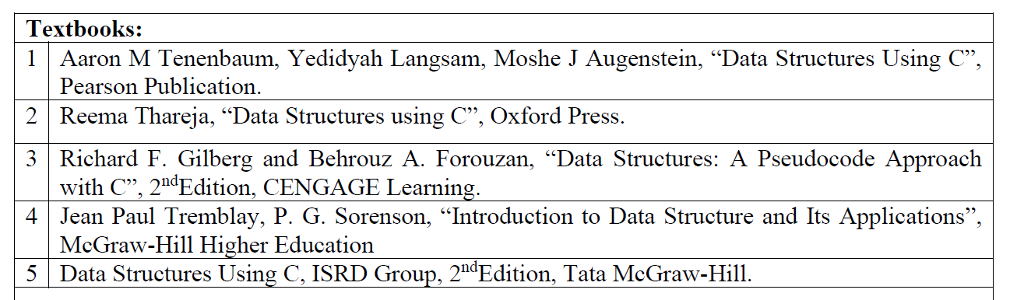
Syllabus
9

Slide 10
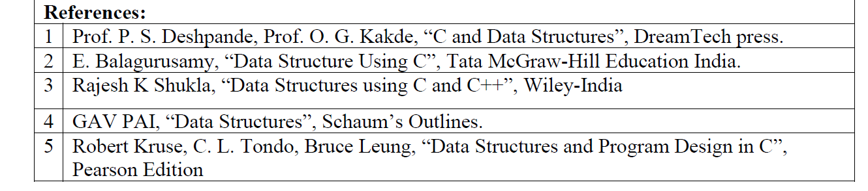
Syllabus
10

Slide 11
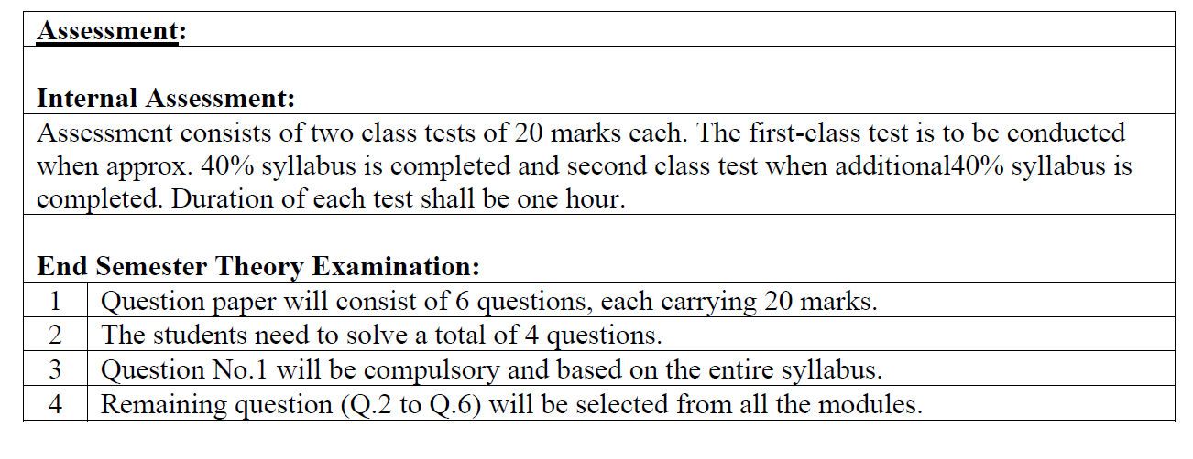
Syllabus
11

Slide 12
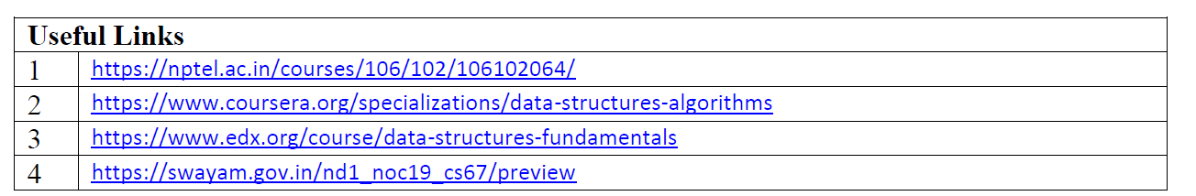
Syllabus
12

Slide 13
Unit I
UNIT - 1 INTRODUCTION TO DATA STRUCTURES
1.Introduction to Data Structures
2. Concept of ADT
3.Types of Data Structures-Linear and Nonlinear 4.Operations on Data Structure
13

Slide 14
Introduction to Data Structures
A data structure is a way of storing data in a computer so that it can be used efficiently and it will allow the most efficient algorithm to be used.
•A data structure should be seen as a logical concept that must address two fundamental concerns.
I. First, how the data will be stored, and
II. Second, what operations will be performed on it.
14

Slide 15
Introduction to Data Structures
Data structure is a particular way of organizing, storing and retrieving data, so that it can be used efficiently. It is the structural representation of logical relationships between elements of data.
Definition :
Where data structures are used?
▪ Data structures are used in almost every program or software system. Different kinds of data structures are suited to different kinds of applications, and some are highly specialized to specific tasks
15

Slide 16
Introduction to Data Structures
Applications in which data structures are applied extensively
o Compiler design (Hash tables),
o Operating system,
o Database management system (B+Trees),
o Statistical analysis package,
o Numerical analysis (Graphs),
o Graphics,
o Artificial intelligence,
o Simulation
16

Slide 17
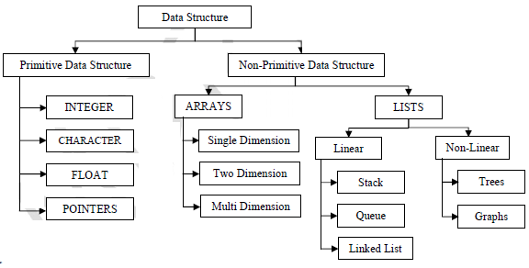
Classification of Data Structures
Data structures can be classified as
17

Slide 18
Introduction to Data Structures
Primitive Data Structure(simple Data Structure)
There are basic structures and directly operated upon by the machine instructions.
Data structures that are directly operated upon the machine-level instructions are known as primitive data structures.
Integer, Floating-point number, Character constants, string constants, pointers etc, fall in this category.
18

Slide 19
Introduction to Data Structures
Primitive Data Structure
The most commonly used operation on data structure are broadly categorized into following types:
◦Create
◦Selection
◦Updating
◦Destroy or Delete
19

Slide 20
Introduction to Data Structures
Non-Primitive Data Structure(Compound Data Structure)
Non-primitive data structures are not defined by the programming language, but are instead created by the programmer
There are more sophisticated data structures.
The Data structures that are derived from the primitive data structures are called Non-primitive data structure.
The non-primitive data structures emphasize on structuring of a group of homogeneous (same type) or heterogeneous (different type) data items.
20

Slide 21
Introduction to Data Structures
Non-Primitive Data Structure
Linear Data structures:
◦ Linear Data structures are kind of data structure that has homogeneous elements.
◦ The data structure in which elements are in a sequence and form a liner series.
◦ Linear data structures are very easy to implement, since the memory of the computer is also organized in a linear fashion.
◦Some commonly used linear data structures are Stack, Queue and Linked Lists.
Linear data structure- only two elements are adjacent to each other. (Each node/element has a single successor)
o Restricted list (Addition and deletion of data are restricted to the ends of the list)
✓ Stack (addition and deletion at top end)
✓ Queue (addition at rear end and deletion from front end)
o General list (Data can be inserted or deleted anywhere in the list: at the beginning, in the middle or at the end)
21

Slide 22
Introduction to Data Structures
Non-Primitive Data Structure
Non-Linear Data structures:
◦ A Non-Linear Data structures is a data structure in which data item is connected to several other data items.
◦Non-Linear data structure may exhibit either a hierarchical relationship or parent child relationship.
◦The data elements are not arranged in a sequential structure.
◦The different non-linear data structures are trees and graphs.
Non-linear data structure- One element can be connected to more than two adjacent elements.(Each node/element can have more than one successor)
o Tree (Each node could have multiple successors but just one predecessor)
o Graph (Each node may have multiple successors as well as multiple predecessors)
22

Slide 23
Introduction to Data Structures
Non-Primitive Data Structure
The most commonly used operation on data structure are broadly categorized into following types:
◦Traversal
◦Insertion
◦Selection
◦Searching
◦Sorting
◦Merging
◦Destroy or Delete
23

Slide 24
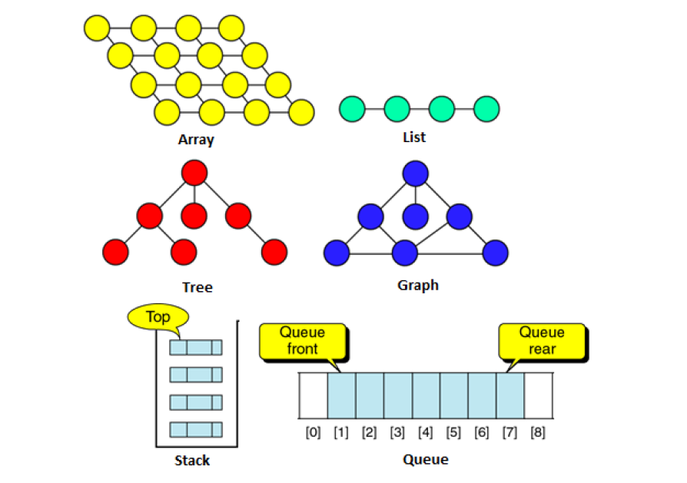
Introduction to Data Structures
24

Slide 25
Introduction to Data Structures
Different between them
A primitive data structure is generally a basic structure that is usually built into the language, such as an integer,
a float.
A non-primitive data structure is built out of primitive data structures linked together in meaningful ways, such as a or a linked-list, binary search tree, AVL Tree, graph etc.
25

Slide 26
Introduction to Data Structures
Linear Data Structure: Arrays
An array is a collection of homogeneous data elements described by a single name. Each element of an array is referenced by a subscripted variable or value, called subscript or index enclosed in parenthesis
•One Dimensional Array
•Two Dimensional Array
•Multidimensional Array
An array is defined as a set of finite number of homogeneous elements or same data items.
It means an array can contain one type of data only, either all integer, all float-point number or all character.
26

Slide 27

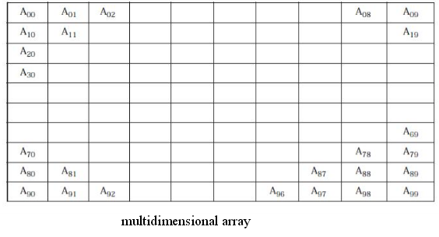
Introduction to Data Structures
Types of arrays :
27

Slide 28
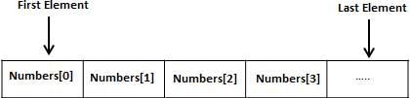
Introduction to Data Structures
C-Arrays
Arrays a kind of data structure that can store a fixed-size sequential collection of elements of the same type.
•An array is used to store a collection of data, but it is often more useful to think of an array as a collection of variables of the same type.
•All arrays consist of contiguous memory locations. The lowest address corresponds to the first element and the highest address to the last element
Declaring Arrays
•type arrayName[ arraySize];
•Eg: intNumber[10];
28

Slide 29
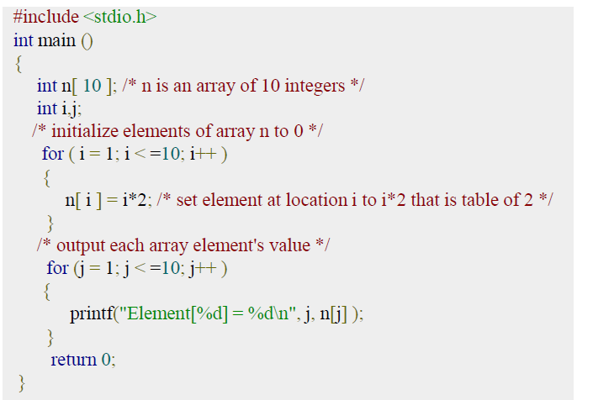
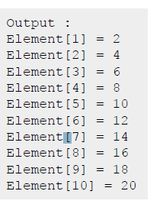
Introduction to Data Structures
Example of Arrays
29

Slide 30
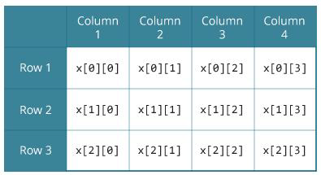
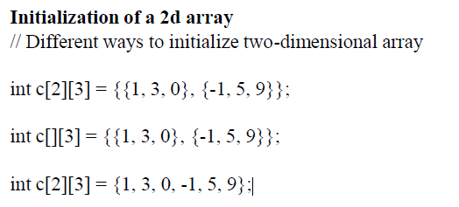
Introduction to Data Structures
Multidimensional Arrays
In C programming, you can create an array of arrays. These arrays are known as multidimensional arrays.
For example, float x[3][4];
Here, x is a two-dimensional (2d) array. The array can hold 12 elements. You can think the array as a table with 3 rows and each row has 4 columns.
30

Slide 31
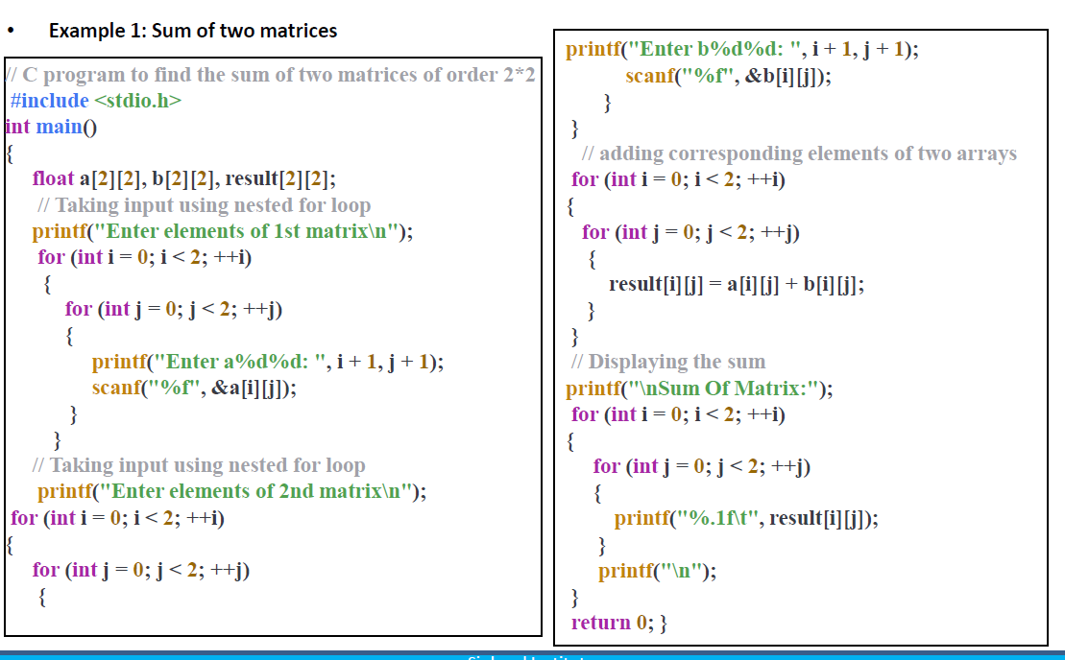
Introduction to Data Structures
Initialization of 3D Array
Initialization of a 3d array
int test[2][3][4] = { {{3, 4, 2, 3}, {0, -3, 9, 11}, {23, 12, 23, 2}}, {{13, 4, 56, 3}, {5, 9, 3, 5}, {3, 1, 4, 9}}};
31

Slide 32
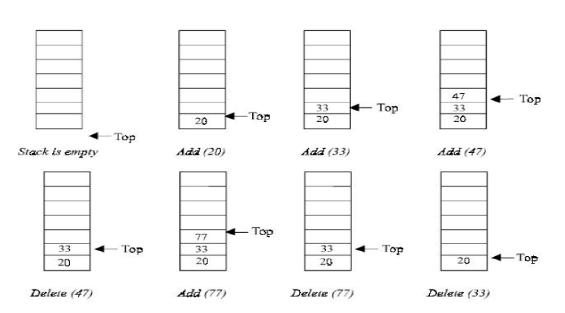
Introduction to Data Structures
Linear Data Structure : Stack
•A stack is one of the most important and useful non primitive Linear data structure in computer science.
•It is an ordered collection of items into which new data items may be added/ inserted and from which items may be deleted at only one end, called the Top of the stack.
•As all the addition and deletion in a stack is done from the top of the stack,
The last added element will be first removed from the stack.
•That is why the stack is also called Last-in-First-out(LIFO)
32

Slide 33
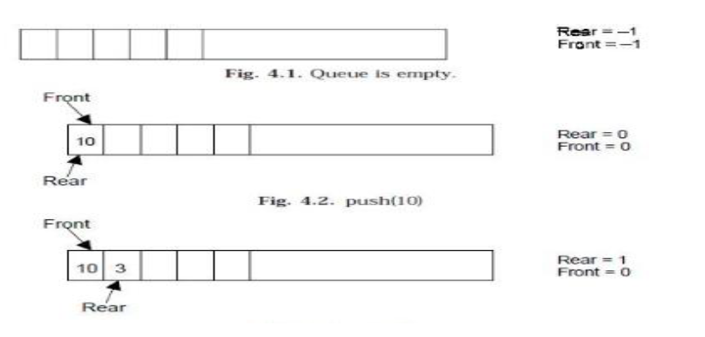
Introduction to Data Structures
Linear Data Structure : Queue
A queue is logically a first in first out (FIFO or first come first serve) linear data structure.
33

Slide 34
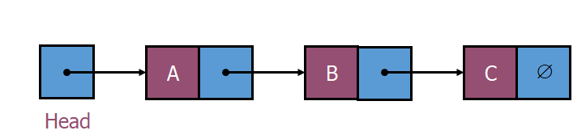
Introduction to Data Structures
Linear Data Structure : Linked List
.
Linked list is a dynamic data structure which is an ordered collection of homogeneous data elements called nodes, in which each element contains two parts: data or Info and one or more links.
The data holds the application data to be processed. The link contains (the pointer) the address of the next element in the list.
34

Slide 35
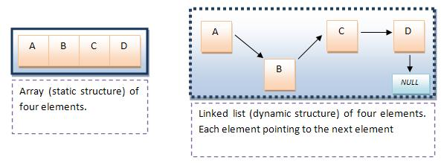
Introduction to Data Structures
Static and Dynamic DS
Static-As same as the word static suggests, static data structures are designed to store static “set of data”.
Dynamic-Dynamic data structures are designed to facilitate change of data structures in the runtime.
35

Slide 36
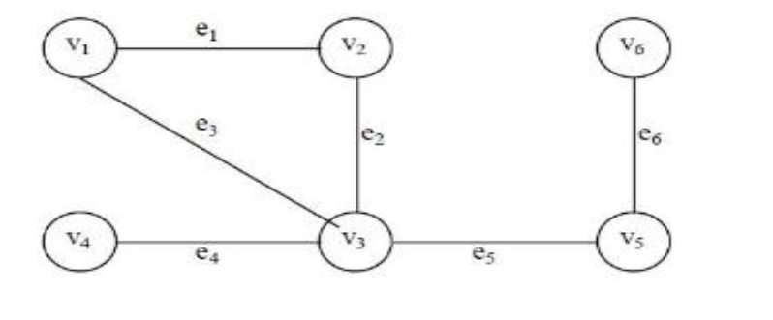
Introduction to Data Structures
Non Linear Data Structure : Graph
Graph A graph can be represent as G=(V,E) Where V is a finite and non empty set at vertices and E is a set of pairs of vertices called edges. Each edge e in E is identified with a unique pair(a,b) of nodes in V denoted by e=[a,b]
36

Slide 37
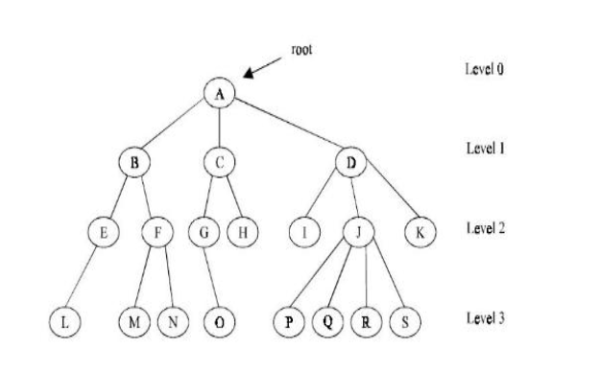
Introduction to Data Structures
Non Linear Data Structure : Tree
Tree can be theoretically defined as a finite set of one or more data items (or nodes) such that :
1. There is a special node called the root of the tree.
2. Removing nodes (or data item) are partitioned into number of mutually exclusive (i.e., disjoined) subsets each of which is itself a tree, are called sub tree
37

Slide 38
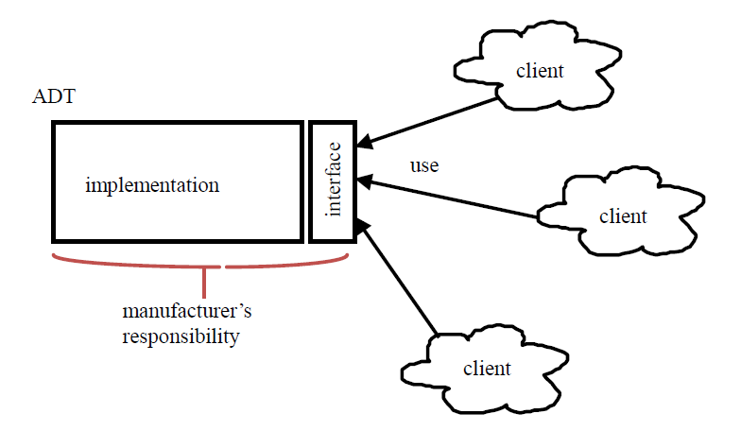
Introduction to Data Structures
Abstract Data Type
Defines a particular data structure in terms of data and operations
2.Offers an interface of the objects (instances of an ADT)
3.An ADT consists of
•Declaration of data
•Declaration of operations
•Encapsulation of data and operations : data is hidden from user and can be manipulated only by means of operations
38

Slide 39
Introduction to Data Structures
Abstract Data Type
An abstract data type, sometimes abbreviated ADT, is a logical description of how we view the data and the operations that are allowed without regard to how they will be implemented.
By providing this level of abstraction, we are creating an encapsulation around the data. The idea is that by encapsulating the details of the implementation, we are hiding them from the user‘s view. This is called information hiding
39

Slide 40
Introduction to Data Structures
Abstract Data Type
What is Abstract Data Type (ADT)?
▪ ADT is a mathematical specification of the data, a list of operations that can be carried out on that data. It includes the specification of what it does, but excludes the specification of how it does. Operations on set ADT: Union, Intersection, Size and Complement.
The primary objective is to separate the implementation of the abstract data types from their function. The program must know what the operations do, but it is actually better off not knowing how it is done. Three most common used abstract data types are Lists, Stacks, and Queues
40

Slide 41
Introduction to Data Structures
Benefits of using ADTs or Why ADTs
Code is easier to understand. Provides modularity and reusability.
Implementations of ADTs can be changed without requiring changes to the program that uses the ADTs.
LIST ADT
List is a linear collection of ordered elements. The general form of the list of size N is: A0, A1, …, AN-1
o Where A1 - First element
o If the element at position 'i' is Ai then its successor is Ai+1 and its predecessor is Ai-1.
AN - Last element
N - Size of the list
41

Slide 42
Introduction to Data Structures
Various operations performed on a List ADT
Insert (X,5) - Insert the element X after the position 5.
o Delete (X) - The element X is deleted.
o Find (X) - Returns the position of X
o Next (i) - Returns the position of its successor element i+1.
o Previous (i) - Returns the position of its Predecessor element i-1.
o PrintList - Displays the List contents.
o MakeEmpty - Makes the List empty.
Implementation of List ADT
o Array implementation
o Linked List implementation
o Cursor implementation
42

Slide 43
Introduction to Data Structures
Thank You….
43

Slide 44
Introduction to Data Structures
44

Slide 45
Introduction to Data Structures
45

